Slide 1
Recurrent Neural Networks
Introduction to memory cells

Slide 2
overview
Recurrent Neural Networks (RNN)are a class of neural networks that can predict the future...
The idea behind RNNs is to make use of sequential information. In a traditional neural network it is assumed that all inputs (and outputs) are independent of each other. But for many tasks that’s a very bad idea. If you want to predict the next word in a sentence you better know which words came before it.
RNNs are called recurrent because they perform the same task for every element of a sequence, with the output being depended on the previous computations.
For certain sequential machine learning tasks, such as speech recognition, RNNs are reaching levels of predictive accuracy, that no other algorithm can match.

Slide 3
Class of RNN problems
Analyze time series data- stock prices
Anticipate trajectories- autonomous driving
Natural language processing- Siri, Google Voice
Sentiment Analysis- document, audio input

Slide 4
Creative tasks
RNN ability to predict the next 'state' permits a certain level of 'creativity'
Google Magenta: composes melodies
https://cdn2.vox-cdn.com/uploads/chorus_asset/file/6577761/Google_-_Magenta_music_sample.0.mp3
Generate sentences
"Why do what that day," replied Natasha, and wishing to himself the fact the princess, Princess Mary was easier, fed in had oftened him. Pierre aking his soul came to the packs and drove up his father-in-law women.
Image Captions
https://arxiv.org/pdf/1411.4555v2.pdf

Slide 5
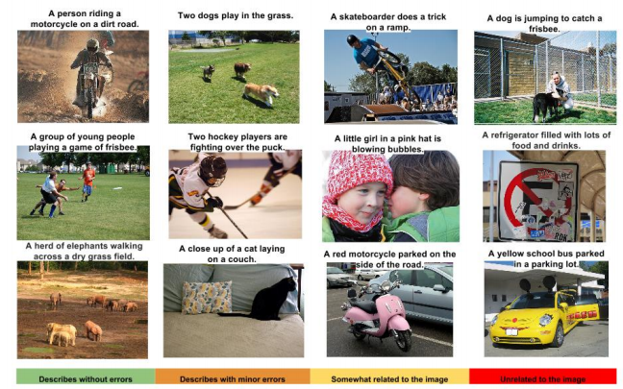
Image captions

Slide 6
RNN problems and solutions
Problems faced by RNNs:
Vanishing/Exploding Gradients
Solutions to help alleviate these issues:
LSTM (Long Short-Term Memory)
GRU (Gated Recurrent Unit)

Slide 7
Memory cell
Memory Cell: That part of a neural network which preserves state across time steps.

Slide 8
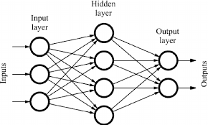
feedforward Network Review
Activations flow in one direction- from the input layer to the output layer.

Slide 9
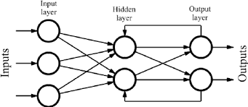
RNN is Different
Recurrent Neural Networks are similar to feedforward neural networks, except they also have connections point backward.

Slide 10
Single recurrent neuron
Y
The simplest RNN contains a single neuron.
The neuron receives input(s).
The neuron produces an output.
The output is sent back to 'itself'.
Σ
X

Slide 11
Unrolling the network through time
Y
(t-2)
Y
(t-1)
Y
(t)
A recurrent neuron receives inputs from time 't' as well as its own output from the previous step 't-1'
Σ
Σ
Σ
X
(t-2)
X
(t-1)
X (t)
TIME

Slide 12
RNN weights
Each recurrent neuron has two set of weights:
A weight for the inputs at X(t)
A weight for the inputs at the previous time step X(t-1)

Slide 13
Rnn activation function
Many researchers prefer to use a (tanh) hyperbolic tangent activation function (over ReLU) for RNNs.
Refer to:
"Dropout Improves Recurrent Neural Networks for Handwriting Recognition"
"A Simple Way to Initialize Recurrent Networks of Rectified Linear Units"

Slide 14
RNN sequences
Sequence to Sequence
Simultaneously take a sequence of inputs and produce a sequence of outputs.
Stock price prediction.
Sequence to Vector (Encoder)
Feed a sequence of inputs, ignore all outputs except for the last one.
Sentiment analysis. (Feed movie review text, output a score)
Vector to Sequence (Decoder)
Feed the network a single input at the first time step and zeros for all other steps and output a sequence.
Input an image, output a caption.
Delayed Sequence to Sequence
Link an Encoder with a Decoder. Feed an encoder a sentence in one language which converts it to a single vector. The vector is decoder would accept the vector and translate into a target language.
Better than a sequence-to-sequence since the last words of the sentence can affect the first words of the translation.

Slide 15
Tensorflow RNN Examples
Hand coded RNN neuron
Tf.contrib.rnn.static_rnn
Tf.nn.dynamic_rnn

Slide 16
Variable length input sequences
Variable length input sequences are typical when using RNNs to process sentences.
The tf.nn.dynamic_rnn method provides the sequence_length parameter to indicate length of the input sequence.
Any input sequence that is shorter than the designated sequence_length must be padded with a zero vector, to fit the input tensor dimension.

Slide 17
Variable-length output sequences
When using RNNs to translate sentence, the input length variation can be zero padded as necessary; however, the translated sentence is generally different in length of the input sentence.
The solution is to define a special output called an end-of-sequence token. (EOS token).
Any output past the EOS token should be ignored.

Slide 18
Training Rnn
The 'trick' used to train an RNN is to unroll it through time and then apply backpropagation.
First there is a forward pass through the unrolled network.
Then the output sequence is evaluated using a cost function.
NOTE: the gradients flow backward through all the outputs used by the cost function, not just through the final output.
ALSO: the same weight and bias parameters are used at each time step.

Slide 19
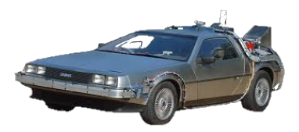
Backpropogation through time (bptt)
The RNN trains its units by adjusting their weights following a slight modification of a feedback process known as backpropogation.
Recurrent neural networks use a heavier version of this process known as backpropogation through time (BPTT). This version extends the tweaking process to include the weight of the T-1 input values responsible for each unit’s memory of the prior moment.

Slide 20
Rnn classifier
A convolution neural network (CNN) is better suited for image classification, however the Geron book provides an example using RNNs to evaluate the MNIST data set.
Surprisingly RNNs produce 98% accuracy without much work.

Slide 21
Times series predictions
The most common example is predicting a stock price.

Slide 22
Vanishing gradients
When training a deep neural network, the larger the gradient, the steeper the slope, the more quickly the system can roll 'downhill' to the finish line and arrive at an optimal solution.
As gradients get smaller and smaller, and thus flatter and flatter, training times grow unbearably long.

Slide 23
Long Short-Term Memory (LSTM)
In the late 90s, a major breakthrough solved the vanishing descent problem.
Long Short-Term Memory (LSTM) gave a second wind to recurrent network development.

Slide 24
Mind the gap
Sometimes, there is only need to look at recent information to perform a task. Consider a language model trying to predict the next word based on the previous ones. Try to predict the last word in “The sky is ___”
Unfortunately, as that gap grows, RNNs become unable to learn to connect the information.
Consider trying to predict the last word in the text “I grew up in France… I speak fluent _____.”

Slide 25
